Slide 1
LESSON 08

Slide 2
Overview
of
Previous Lesson(s)

Slide 3
Over View
Syntax-directed translation is done by attaching rules or program fragments to productions in a grammar.
An attribute is any quantity associated with a programming construct .
A translation scheme is a notation for attaching program fragments to the productions of a grammar.

Slide 4
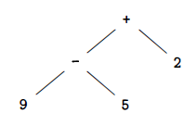
Over View..
In an abstract syntax tree for an expression, each interior node represents an operator, the children of the node represent the operands of the operator.
Abstract Syntax tree for 9-5+2

Slide 5
Over View…
Structure of our Compiler
Source
Program (Character stream)
Lexical analyzer
Syntax-directed translator
Token stream
Java bytecode
Develop parser and code generator for translator
Syntax definition (BNF grammar)
JVM specification

Slide 6
Over View…
Typical tasks performed by lexical analyzer
Removal of white space and comments
Encode constants as tokens
Recognize keywords
Recognize identifiers
Store identifier names in a global symbol table

Slide 7
TODAY’S LESSON

Slide 8
Contents
Symbol Tables
Symbol Table Per Scope
The Use of Symbol Tables
Intermediate Code Generator
Syntax Directed Translator Flow
Role of the Lexical Analyzer
Tokens, Patterns & Lexemes
Attributes for Tokens
Lexical Errors
Input Buffering
Buffer Pairs

Slide 9
Symbol Tables
Symbol tables are data structures that are used by compilers to hold information about source-program constructs.
Information is put into the symbol table when the declaration of an identifier is analyzed.
Entries in the symbol table contain information about an identifier such as its character string (or lexeme) , its type, its position in storage, and any other relevant information.
The information is collected incrementally.

Slide 10
Symbol Table Per Scope
If the language you are compiling supports nested scopes, the lexer can only construct the <lexeme,token> pairs.
The parser converts these pairs into a true symbol table that reflects the nested scopes.
If the language is flat, the scanner can produce the symbol table.
Key idea is, when entering a block, a new symbol table is created.
Each such table points to the one immediately outer table.

Slide 11
Use of Symbol Table
A semantic action gets information from the symbol table when the identifier is subsequently used, for example, as a factor in an expression.
Now there are two important forms for the intermediate code generator
Trees, especially parse trees and syntax trees.
Linear, especially three-address code

Slide 12
Intermediate Code Generator
Static checking refers to checks performed during compilation, whereas, dynamic checking refers to those performed at run time.
Examples of static checks include
Syntactic checks such as avoiding multiple declarations of the same identifier in the same scope.
Type checks.

Slide 13
Intermediate Code Generator..
L-values and R-values
Consider Q = Z; or A[f(x)+B*D] = g(B+C*h(x,y));
Three tasks:
Evaluate the left hand side (LHS) to obtain an l-value.
Evaluate the RHS to obtain an r-value.
Perform the assignment.
An l-value corresponds to an address or a location.
An r-value corresponds to a value.
Neither 12 nor s+t can be used as an l-value, but both are legal r-values.

Slide 14
Intermediate Code Generator...
Static checking is used to insure that R-values do not appear on the LHS.
Type Checking assures that the type of the operands are correct as per the operator and also reports error, if any.
Coercions The automatic conversion of one type to another.
Overloading Same symbol can have different meanings depending on the types of the operands.

Slide 15
Three Address Code
These are primitive instructions that have one operator and (up to) three operands, all of which are addresses.
One address is the destination, which receives the result of the operation,
Other two addresses are the sources of the values to be operated on.
Ex.
ADD x y z
MULT a b c
ARRAY_L q r s
ifTrueGoto x L

Slide 16
Syntax Directed Translator Flow
The starting point for a syntax-directed translator is a grammar for the source language.
A grammar describes the hierarchical structure of programs.
It is defined in terms of elementary symbols called terminals and variable symbols called nonterminals.
These symbols represent language constructs.

Slide 17
Syntax Directed Translator Flow..
The productions of a grammar consist of a non terminal called the left side of a production and a sequence of terminals and non terminals called the right side of the production.
One non terminal is designated as the start symbol.
A lexical analyzer reads the input one character at a time and produces as output a stream of tokens.
A token consists of a terminal symbol along with additional information in the form of attribute values.

Slide 18
Syntax Directed Translator Flow...
Parsing is the problem of figuring out how a string of terminals can be derived from the start symbol of the grammar by repeatedly replacing a non terminal by the body of one of its productions.
Efficient parsers can be built, using a top-down method called predictive parsing.
A syntax-directed definition attaches rules to productions, the rules compute attribute vales.

Slide 19
Syntax Directed Translator Flow...
A translation scheme embeds program fragments called semantic actions in production bodies.
The actions are executed in the order that productions are used during syntax analysis.
The result of syntax analysis is a representation of the source program, called intermediate code.
An abstract syntax tree has nodes for programming constructs, the children of a node give the meaningful sub constructs.

Slide 20
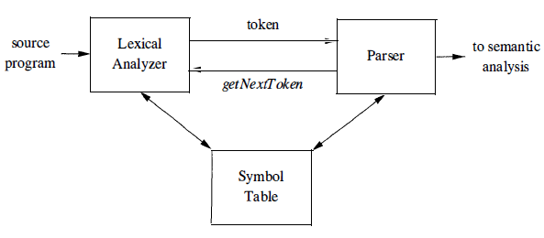
Role of Lexical Analyzer

Slide 21
Role of Lexical Analyzer..
Sometimes, lexical analyzers are divided into a cascade of two processes:
Scanning consists of the simple processes that do not require tokenization of the input, such as deletion of comments and compaction of consecutive whitespace characters into one.
Lexical analysis is the more complex portion, where the scanner produces the sequence of tokens as output.

Slide 22
Lexical Analysis Vs Parsing
There are a number of reasons why the analysis portion is normally separated into lexical analysis and parsing.
The separation of lexical and syntactic analysis often allows us to simplify at least one of these tasks.
Compiler efficiency is improved. A separate lexical analyzer allows to apply specialized techniques that serve only the lexical task, not the job of parsing.
Compiler portability is enhanced. Input-device-specific peculiarities can be restricted to the lexical analyzer.

Slide 23
Tokens, Patterns & Lexemes
A token is a pair consisting of a token name and an optional attribute value.
The token name is an abstract symbol representing a kind of lexical unit, e.g., a particular keyword, or sequence of input characters denoting an identifier.
A pattern is a description of the form that the lexemes of a token may take.
In the case of a keyword as a token, the pattern is just the sequence of characters that form the keyword.
A lexeme is a sequence of characters in the source program that matches the pattern for a token and is identified by the lexical analyzer as an instance of that token.

Slide 24
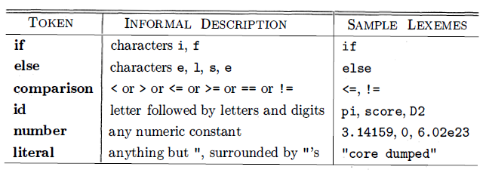
Tokens, Patterns & Lexemes..
In many programming languages, the following classes cover most or all of the tokens:

Slide 25
Attributes for Tokens
For tokens corresponding to keywords, attributes are not needed since the name of the token tells everything.
But consider the token corresponding to integer constants. Just knowing that the we have a constant is not enough, subsequent stages of the compiler need to know the value of the constant.
Similarly for the token identifier we need to distinguish one identifier from another.
The normal method is for the attribute to specify the symbol table entry for this identifier.

Slide 26
Attributes for Tokens..
Ex. The token names and associated attribute values for the Fortran statement E = M * C² are as follows:
<id, pointer to symbol-table entry for E>
<assign_op>
<id, pointer to symbol-table entry for M>
<mult_op>
<id, pointer to symbol-table entry for C>
<exp_op>
<number, integer value 2>

Slide 27
Lexical Errors
Lexical analyzer didn’t always predict errors in source code without the aid of other components.
Ex. String fi is encountered for the first time in a program in the context:
fi ( a == f (x) ) …
A lexical analyzer cannot tell whether fi is a misspelling of the keyword if or an undeclared function identifier.
fi is a valid lexeme for the token id, the lexical analyzer must return the token id to the parser and let parser in this case - handle an error due to transposition of the letters.

Slide 28
Lexical Errors..
If a lexical analyzer is unable to proceed because none of the patterns for tokens matches any prefix of the remaining input. The simplest recovery strategy is "panic mode" recovery.
In this strategy we delete successive characters from the remaining input, until the lexical analyzer can find a well-formed token at the beginning of what input is left.

Slide 29
Lexical Errors...
Other possible error-recovery actions are:
Delete one character from the remaining input.
Insert a missing character into the remaining input.
Replace a character by another character.
Transpose two adjacent characters.

Slide 30
Input Buffering
Determining the next lexeme often requires reading the input beyond the end of that lexeme.
Ex.
To determine the end of an identifier normally requires reading the first whitespace character after it.
Also just reading > does not determine the lexeme as it could also be >=.
When you determine the current lexeme, the characters you read beyond it may need to be read again to determine the next lexeme.

Slide 31
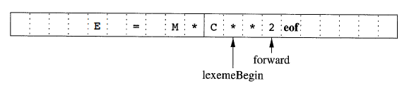
Buffer Pairs
Specialized buffering techniques have been developed to reduce the amount of overhead required to process a single input character.
An important scheme involves two buffers that are alternately reloaded.

Slide 32
Buffer Pairs
Each buffer is of the same size N , and N is usually the size of a disk block, e.g., 4096 bytes.
Using one system read command we can read N characters into a buffer, rather than using one system call per character.
If fewer than N characters remain in the input file, then a special character, eof, marks the end of the source file.
Two pointers to the input are maintained:
Pointer lexemeBegin, marks the beginning of the current lexeme, whose extent we are attempting to determine.
Pointer forward scans ahead until a pattern match is found.

Slide 33
Thank You

